Slide 1

STRATEGIC PARTNERSHIP PROJECTS IN ERASMUS+
WHAT IMPACT CAN BE EXPECTED?
ICERI 2023
Seville (Spain) - 13th - 15th November 2023.
Thorleif Hjeltnes and Anne Fox
Notes:
9 Conversations is an -Entrepreneurship projects for adults with supposrt from EU in. The target group is immigrants and refugees.

Slide 2


Two main Cases
Refugees have skills from their previous life
Learning about entrepreneurship by network-building is helping refugees to start their own business:
Facilitating Migrant Entrepreneurship (Train the facilitators):

Slide 3
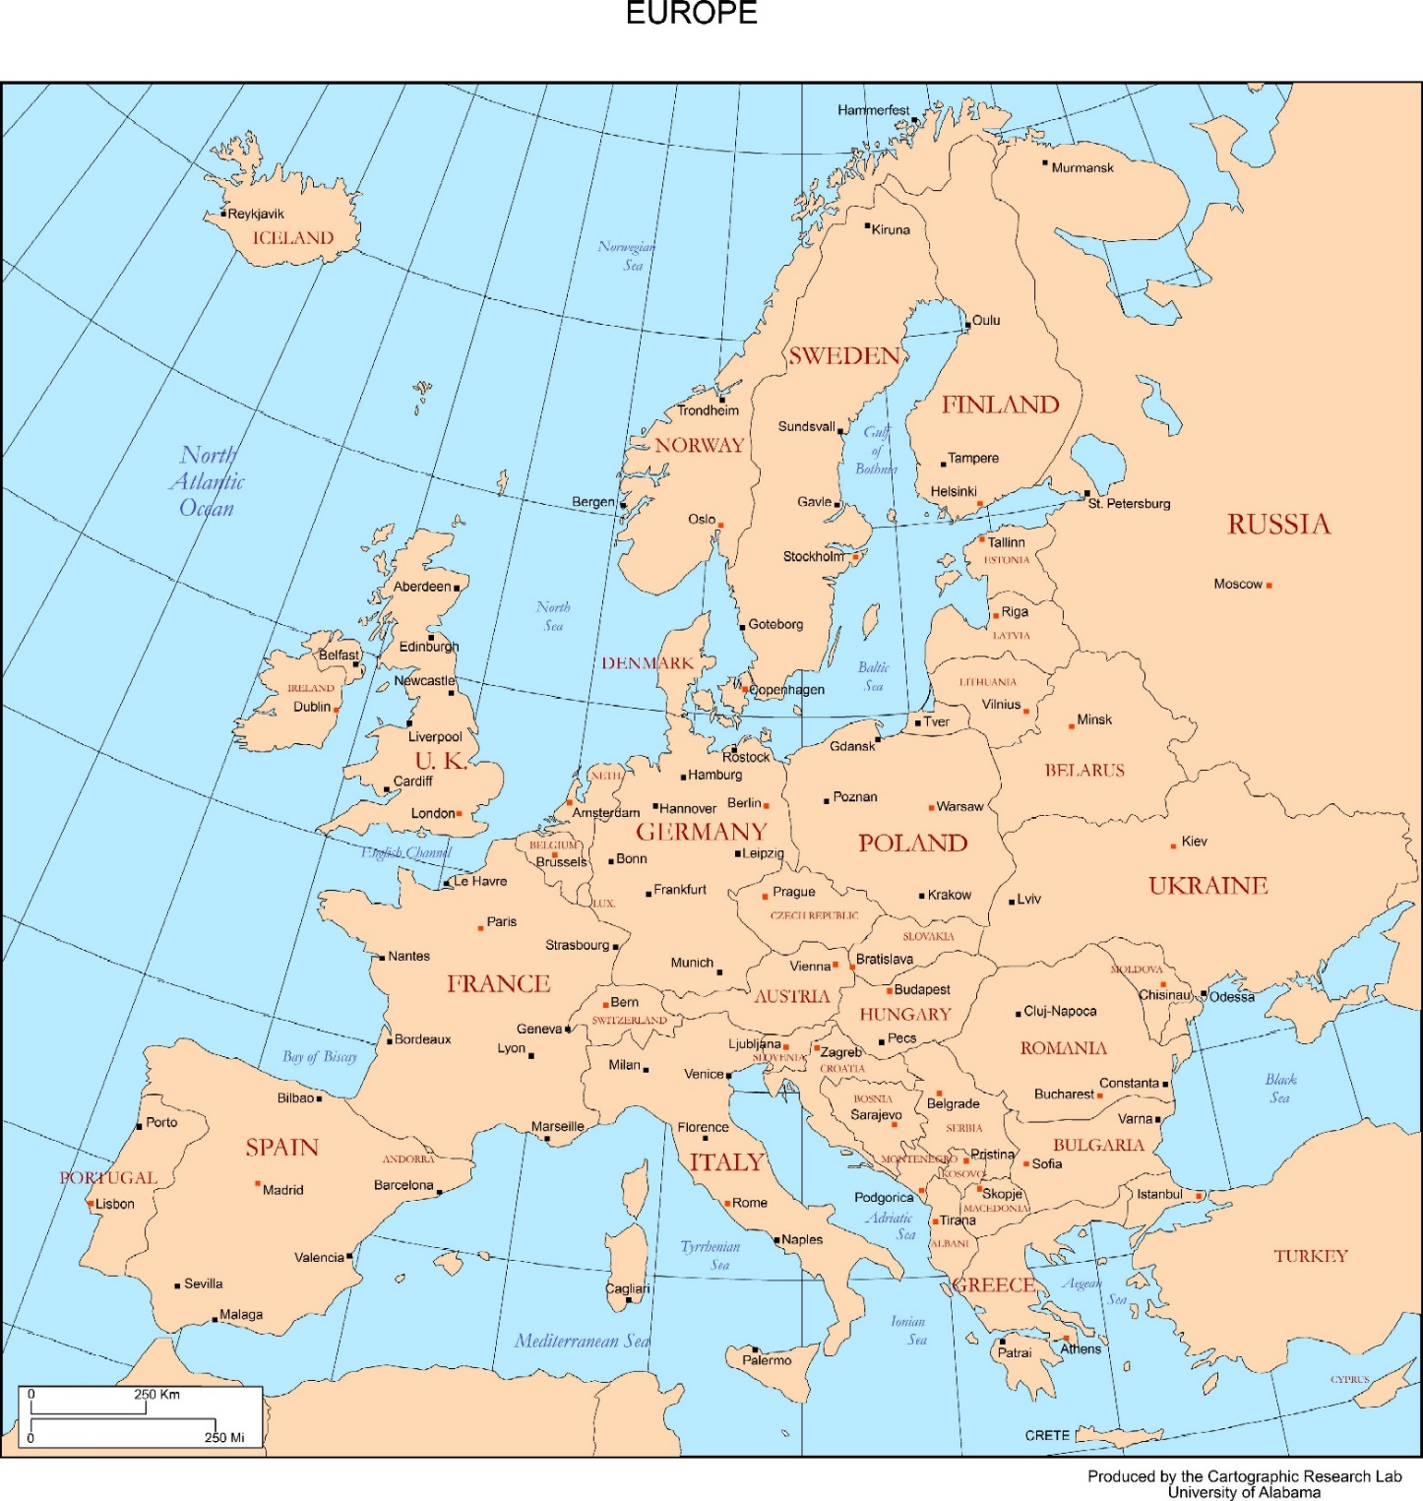






Notes:
We are 6 partners: 4 from the nordic and baltic countries and two from the Mediterainian countries

Slide 4
Impact
Important evaluation criteria by the the EU / the National Agency
40% weight in the Final report evaluation
Definition, Cambridge Dictionary:
«a powerful effect that something, especially sometning new, has on a situation or person»

Slide 6
Target groups (for impact) - I
Learners:
Refugees and immigrants – 9 Conversations
Refugee Support Organizations (RSO) – Mastering 9 Conversations
Partner organisations:
TISIP – Reseach institute and vocational school
NTNU –the larges university in Norway
Norsk Interactive AS – a software developer in Norway (9C only)
University of Rome
International Hellenic University
SPI – Small institute for social projects in Lithuania in close connection with
large Social service center for refugees in Jonava district
CrEA – Refugee supporting organisastion

Slide 7
Target groups (for impact) - II
Project staff:
Teachers
Researchers
Managers
Systemic:
National refugee organisations in Partner countries
National refugee organisations in other EU countries
EU – employment and education efforts

Slide 8


Slide 10
Impact
Staff
Learners
Technology use:
  Wordpress, Lifter, H5P
Entrepreneurship:
  EU Entrecomp framework
  EU skills profile tools
Adapting learning activities:
  Use Universal Design for Learning (UDL)
  principles i making the outputs for
  learners with weak host language
  skills and various educational
  background
No pilot funding from EU,
But a local pilot funded by the Danish partner yielded positive feedback, particularly on the cohort group model

Slide 11
Impact
Organization
SYSTEMIC
IHU: contribution to a new Research Institute on "Refugees Flow and Crisis Management"
Norsk Interactive AS: App development
For all:
Increased knowledge of refugee needs
Use of UDL
micro-credentialling and
the pedagogy of transformative learning circles.
Establish better connections between the Partners in 9C
with refugee supporting organizations in Greece, Italy and Lithuania
Feedback to EU of EU skills profile tool to cover entrepreneurship in a better way.

Slide 12
Impact
Staff
Learners
TISIP and NTNU:
Implementing the cources on a low tech platform
U of Rome:
How to implement
Micro credentials
Still no pilot funding from EU,
The 9C and M9C courses was presented shortly to refugees and refugee supporting organizations at Multiplier events. They that gave positive feedback and wanted to use the courses (Letter of intent)

Slide 13
Impact
Organization
SYSTEMIC
IHU:
Developed a Entrepreneurship diagnostic tool and used it in their university courses.
Crea:
Implementing 9C and M9C for their further work with refugees in Italy
SPI, SSC in Janova and Red Cross:
Implementing 9C and M9C for their further work with refugees in Lithuania
M9C used pre-existing EU tools as vital parts of the package:
EntreComp framework of entrepreneurial skills,
EuroPass approach to certification
EU Skills Profile tool for third country nationals.
A survey of previous Erasmus projects to uncover materials to add to the enhanced two-level version of 9C.

Slide 14
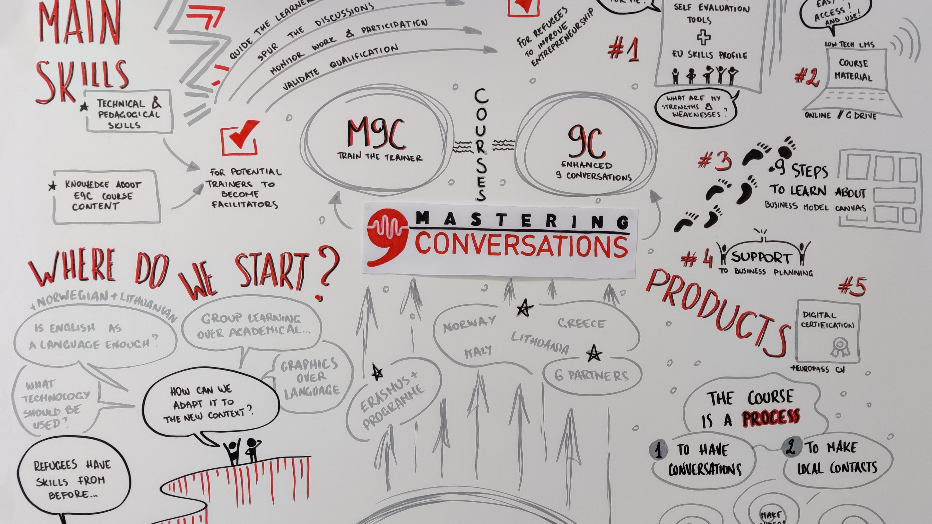

Slide 15
JITOL (1992 – 94) – long term impact
Impact: “The project will have been successful if it is possible to define effective functionality for a service provider and to be able to identify features of knowledge exchange and training needs which can be satisfied by a particular implementation of the JITOL model.”
Norway / NITOL ( A national implementation of JITOL):
Sør-Trøndelag University college (which institutionalized NITOL) was rated as number 23 of the largest e-learning providers in Europe with 2500 enrolments on 148 different courses in 2005.
the impact from JITOL and NITOL have been great, both in number of courses and enrolments, but probably even more important was the lifelong learning effect for individuals and organizations.

Slide 16
Conclusions
Three observations about impact in Erasmus+ strategic partnerships are:
To be approved, a balance is needed between development activities and planned impact and dissemination activities during the lifetime of the project.
The final beneficiary report must be completed within two months of the funding period’s end, which may be too short for significant impacts.
The most significant impacts likely occur much later, such as the adoption of a course developed within a project by partner organizations.

Slide 17
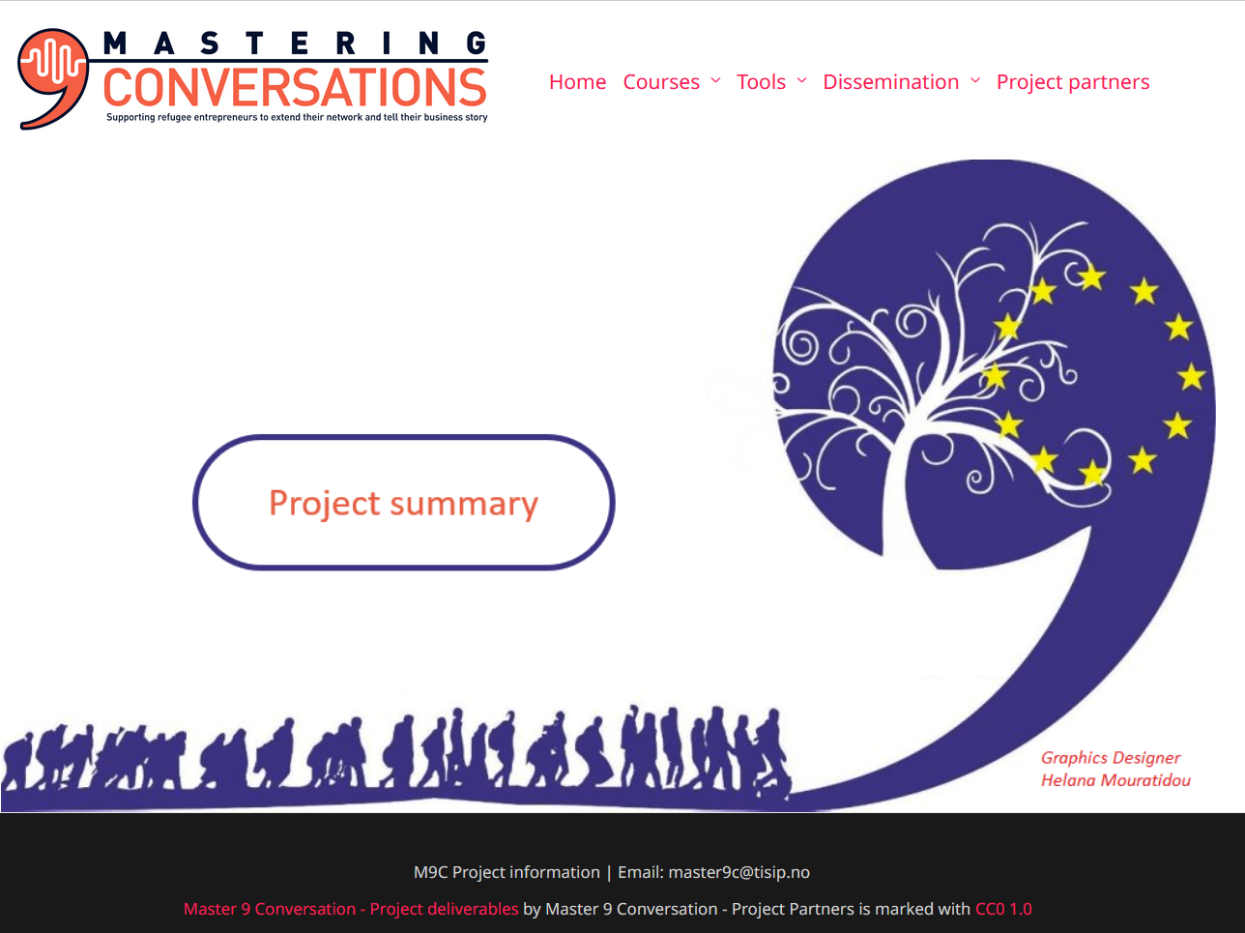
Thank you for listening
https://m9c.idi.ntnu.no/

